Slide 1

COLOR DETECTION
Presented By : Sahil Vijay Pisal
Date : 16/02/2025
Project guide: Prof. Prajyot Patil
Team Members :
Om Nandkumar Ghorpade
Sahil Vijay Pisal
Vaishnav Ingale

Slide 2
Project Overview
Project Description
This project involves developing a deep learning model capable of detecting and classifying colors in images. The model is trained to recognize various colors, identify their dominant hues, and classify them accordingly. The primary goal is to build a system that can accurately detect and classify colors in real-time or static images, which can be applied in multiple fields, including computer vision, digital art, fashion, and design.
Goal
1. Develop a color detection system that can analyze and classify the colors present in an image or video.
2. Utilize deep learning models for feature extraction and color classification to ensure high accuracy.
3.Deploy a user-friendly interface for real-time color detection, with the ability to visualize color labels and percentages.
Context
The context of the Color Detection Deep Learning Project is rooted in the field of computer vision, where the goal is to enable machines to understand and process images the way humans perceive colors. Detecting and classifying colors from images using deep learning models opens up a wide range of real-world applications, from enhancing digital experiences to improving accessibility and design tasks.

Slide 3
Problem Statement
Description:
This project ( color detection) involves developing a deep learning model capable of detecting and classifying colors in images. The model is trained to recognize various colors, identify their dominant hues, and classify them accordingly. The primary goal is to build a system that can accurately detect and classify colors in real-time or static images, which can be applied in multiple fields, including computer vision, digital art, fashion, and design.
Issues:
1.Color Variations Due to Lighting Conditions
2.Shadows and Image Noise
3.Color Ambiguity and Subtle Variations
Key Challenges:
Lighting and Environment: Handling variations in lighting and shadow in images can lead to incorrect color detection.
Color Ambiguity: Some colors might be difficult to classify due to varying shades and subtle differences.
Model Efficiency: Real-time applications require optimization to ensure the model runs efficiently on devices with limited resources.

Slide 4
Data Related Information
Data Structure
1.Data Set Used : colors with there color code.
2.Number of images : depends upon input.
3.Image dimensions : varying sizes,standard image size.
Data Representation
coloumns
1.csv name.
2.color code.
3.corresponding R,G,B values.
Data types
Categorical: color name.
Numerical: color codes and corresponding R,G,B values.
Data pattern and trends
Color Distribution and Frequency of Occurrence
HSV Space Patterns (Hue, Saturation, and Value)
Lighting and Environmental Conditions

Slide 5
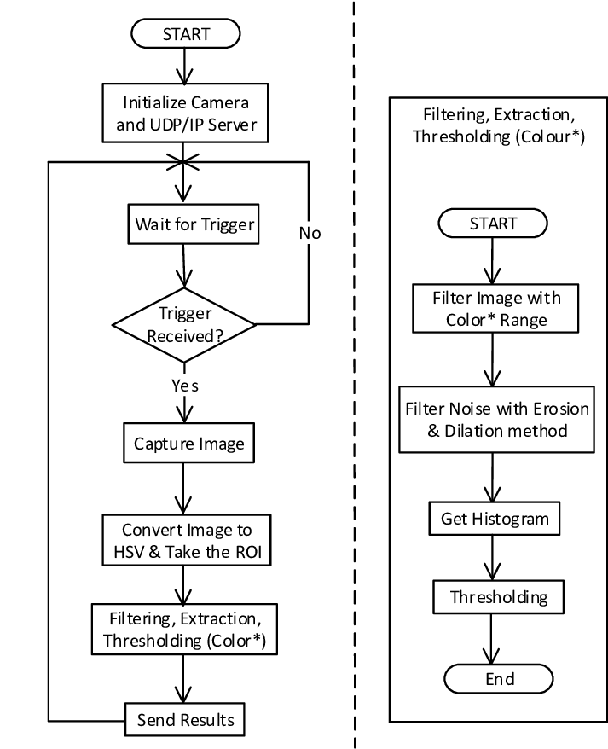
Project Flow

Slide 6
Methodology
Define the Problem
Color name (e.g., red, blue)
RGB values (red, green, blue components)
Frequency (how often the color appears in the image)
Data Collection
Input Type: Images (static)
Format: Images are typically in formats like jpg. , png.
Image Preprocessing
Resize the image for faster processing (optional).
Convert the image to a suitable color space (e.g., RGB if the image is in BGR, which is OpenCV’s default color format).
Frequency Calculation
1.Count how many pixels in the image correspond to each detected color.
2.For a more refined count, calculate how many pixels fall into each cluster in the case of K-means.

Slide 7
Team Members
TEAM MEMBER NAME | INDIVIDUAL ROLE | KEY CONTRIBUTION
1.Om Nandkumar Ghorpade | Python Machine Learning | Team work coordination, Timely execution of each task
2.Vaishnav Ingale | Python deep Learning | Explaining project details, Contributing in projects progress
3.Sahil Vijay Pisal | Data analysis | Collecting data requirements and ensuring timely executions of work

Slide 8
Advantages and Disadvantages
ADVANTAGES
1.Simple Implementation (K-Means Clustering):
2.Automation:
3.Scalability:
4.Data Storage and Organization:
.
DISADVANTAGES
1.K-Means Clustering Limitations.
2.Computational Complexity.
3.Color Name Mapping.
4.Color Detection in Complex Images

Slide 9
Why this problem is important
Impact of Solving the Color Detection Problem
1.Enhanced User Experience
2.Increased Efficiency in Automated Systems
3.Better Marketing and Branding
Relevence to the audience
1.Business Owners and Entrepreneurs
2.Developers and Data Scientists
3.Healthcare Professionals
Expected improvement and outcomes
1.Improved Accuracy and Precision
2.Enhanced Efficiency in Automation and Robotics
3.Cost Savings

Slide 10

Screenshot Or Visuals

Slide 11

Project Code

Slide 12
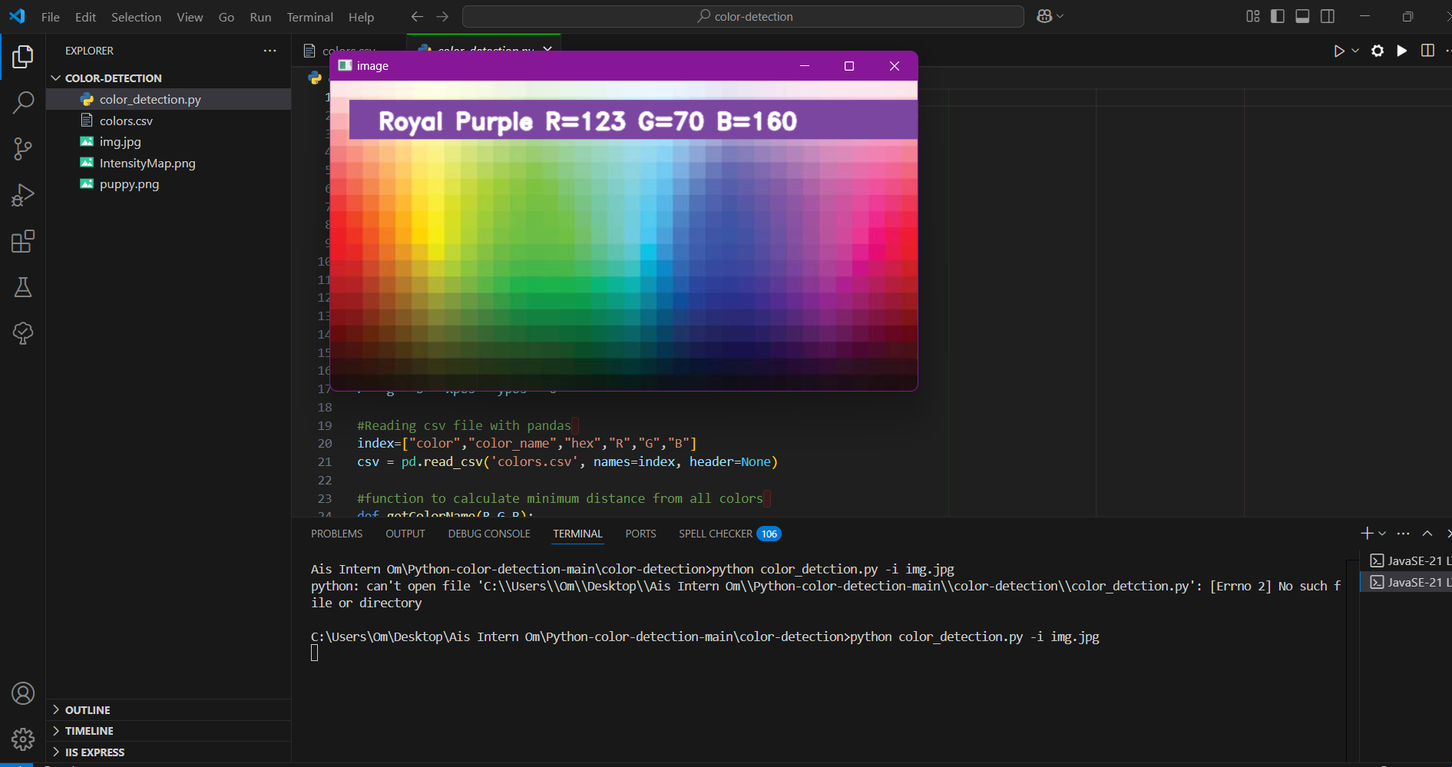
Project Output

Slide 13

Dataset Used

Slide 14
Synopsis
Synopsis: Color Detection Project
The Color Detection project focuses on the development of an advanced system to automatically detect and analyze colors in digital images or video streams. The core objective is to leverage machine learning and computer vision technologies to accurately identify colors in various contexts, enabling applications across industries such as e-commerce, healthcare, agriculture, manufacturing, and more.
Color detection refers to the ability of a system or software to identify and classify colors present in an image. By leveraging sophisticated algorithms, sensors, or cameras, this project aims to create an automated process capable of identifying color information in a wide range of objects, environments, or conditions.

Slide 15
Expected Conclusion
Final thoughts and key takeway
1.Versatility and Wide Applicability: Color detection is a versatile technology with the potential to revolutionize numerous industries, including healthcare, retail, agriculture, robotics, and more.
2.Enhancing Automation: Automating the process of color detection helps reduce manual errors, improve operational efficiency
Future Directions for the Color Detection Project
1.Context-Aware Color Detection: Future systems could use deep learning to not only detect colors but also understand the context in which those colors are used.
2.Self-Improving Models: By utilizing reinforcement learning or other advanced AI techniques, color detection systems could adapt

Slide 16
Research Paper
Paper Name | Objective | Data | Methods
Color Detection Using OpenCV | To detect and classify colors in images and store results in CSV. | Images (JPG/PNG). Output: CSV with RGB/HSV values. | OpenCV for image processing. Thresholding for color extraction.
Automated Color Classification | To classify colors in images and store results in CSV. | E-commerce product images. Output: CSV with detected colors. | Thresholding and HSV conversion. Data storage in CSV using Pandas.
Color Detection for Manufacturing Quality | To detect color defects in manufacturing and store data for analysis. | Manufacturing images. Output: CSV with color data. | OpenCV for color defect detection. Pandas for data storage.
Object Detection Using Color in Python | To detect objects based on color and store results in CSV. | Object images (e.g., fruits). Output: CSV with color and coordinates. | OpenCV for color-based object detection. CSV storage with Pandas.
Real-Time Agriculture Color Detection | To monitor crop health in real-time and store data in CSV format. | Agricultural images (e.g., crops). Output: CSV with detected color values. | Real-time image processing with OpenCV. Thresholding for color detection. Pandas for CSV logging.

